Slide 1

Benazir Bhutto Shaheed University Karachi
Department of CS & IT
Batch Evening
Instructor Name: Sir Abdullah
Topic of presentation: Constructor and Destructor
Group Members Names,
Name: Muhammad Mubashir Roll Number: 28
Name: Muhammad Nasrullah Roll Number:29

Slide 2
Constructor
A constructor in Java is a special method that is used to initialize objects

Slide 3
Java Constructor
Constructor is a special method which is invoked automatically at the time of object creation.
Constructors have the same name as class or structure
Constructors don’t have a return type. (Not even void)
Constructors are only called once, at object creation.
Only an access Modifier is allowed such as public , private , protected, default

Slide 4
Types of Constructor:
There are three type of java constructor
Non-Parameterized constructor
1:A constructor which has no argument is known as non-parameterized constructor(or no-argument constructor).
2: It is invoked at the time of creating an object.
3: . If we don’t create one then it is created by default by Java.

Slide 5
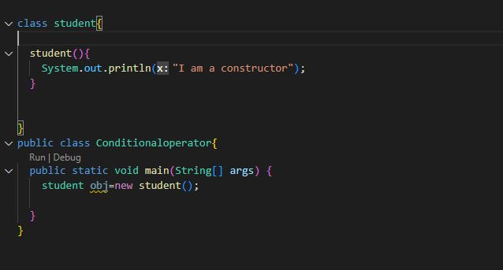
Output:
I am a Constructor

Slide 6
2. Parameterized constructor .
1: Constructor which has parameters is called a parameterized constructor.
2:. It is used to provide different values to distinct objects.
3: It is used to provide different parameter it is also know as constructor overloading.
4:There can be more then two constructor.
5: To creating the constructor and passes different values not to create the setter method to set the data but create the getter to get our data

Slide 7
Example:
class Student {
String name;
int age;
Student(String name, int age) {
this.name = name;
this.age = age;
}
}

Slide 8
3. Copy Constructor :
1: A Copy constructor is an overloaded
constructor used to declare and initialize an object from another object
2: A Copy constructor is an overloaded
constructor used to declare and initialize an object from another object

Slide 9
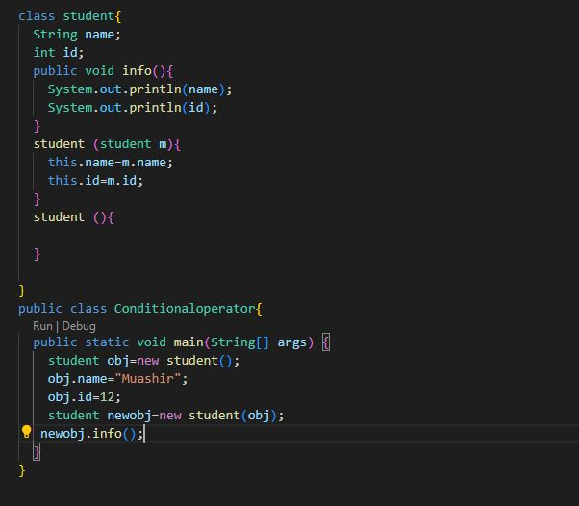

Slide 10
Destructor
1: A destructor, as the name implies is used to destroy the objects that have been created by a constructor.
2: A destructor is called to de-allocate and free memory.
3:A destructor never takes any argument nor does it return any value.
Example of Destructor
Class Object { protected void finalize() { //statements } }

Slide 11
Characteristics of Destructor
1:Destructor function are invoked automatically when the objects are destroyed.
2:if the class has a destructor each object of that class will be de­ intialized before the objects goes out of scope.
3:destructor function obeys the usual access rules.
4: No arrguments can be provided to a destructor neither does it returns any value.
5: They can not be inherited.
A destructor may not be static

Slide 12
Difference Between Constructor and Destructor
Constructor
Destructor
A constructor is used to initialize the state of an object.
A constructor must not have a return type.
The constructor is invoked implicitly
The Java compiler provides a default constructor if you don't have any constructor in a class.
The constructor name must be same as the class name.
A method is used to expose the behaviour of an object.
A method must have a return type.
The method is invoked explicitly.
The method is not provided by the compiler in any case.
The method name may or may not be same as the class name

Slide 13
THANK YOU……!

